Slide 1
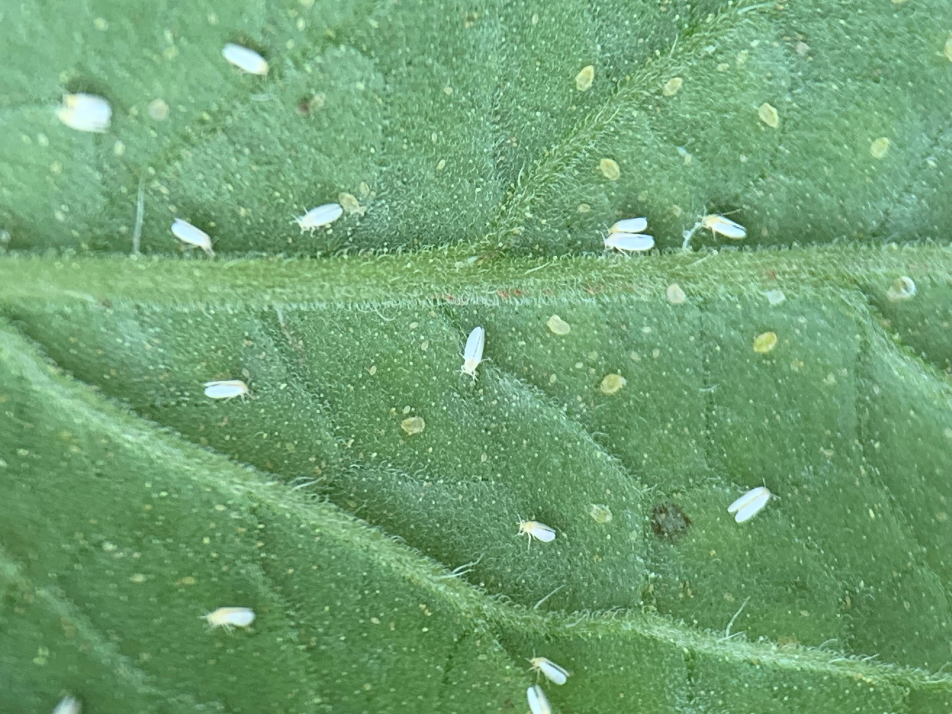
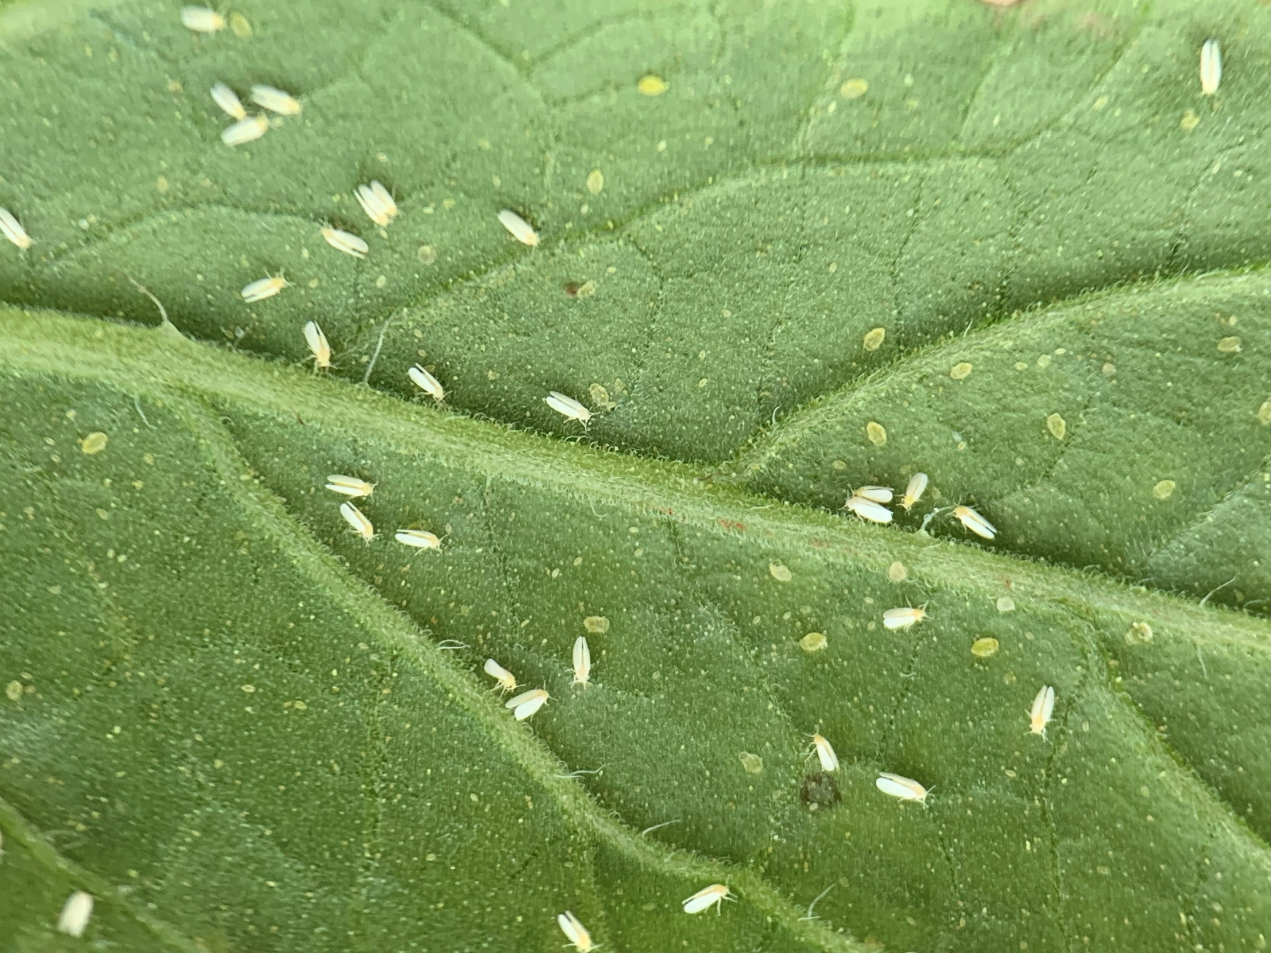
Aleyrodid Counting
Original Picture

Slide 2
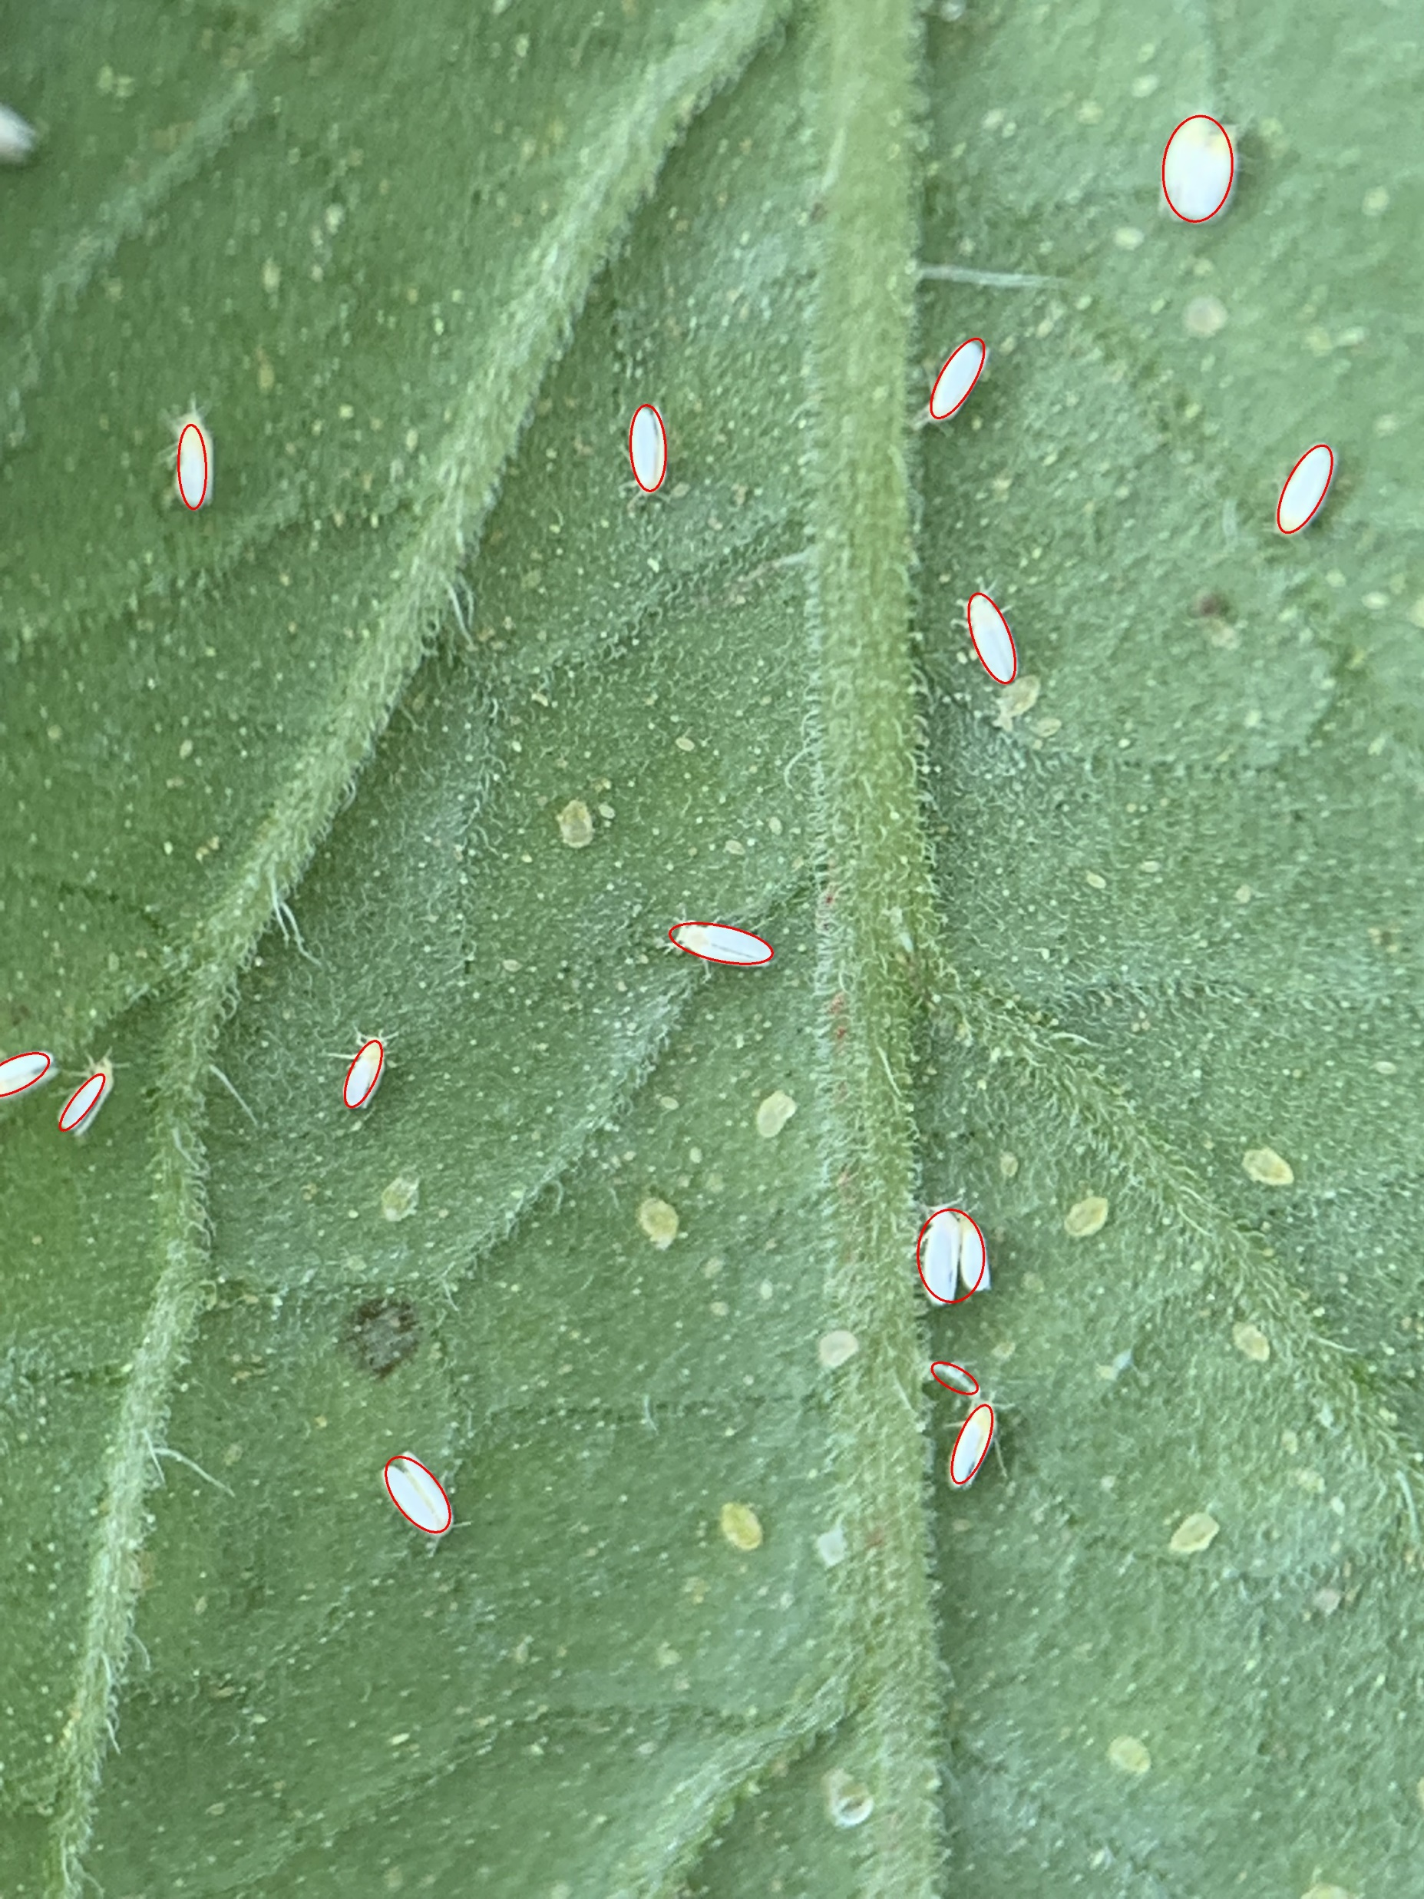
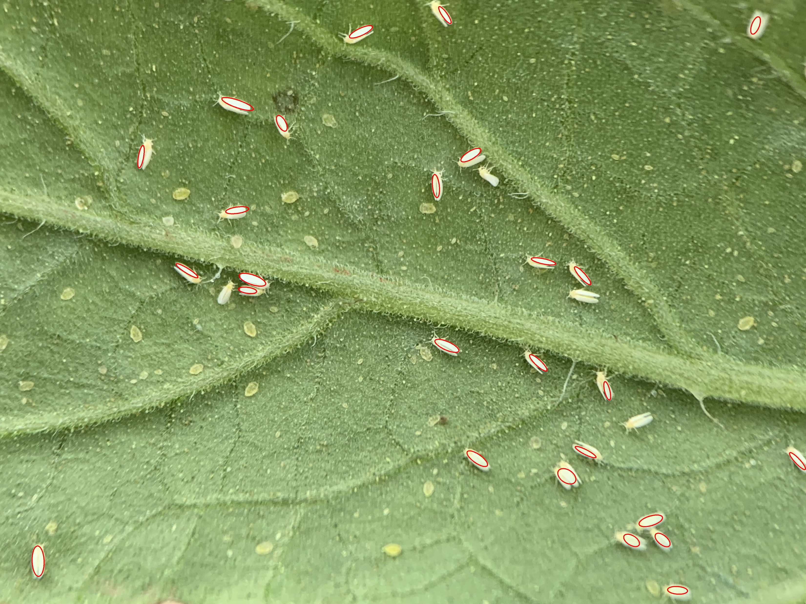
Aleyrodid Counting
Counting: 14
Result Picture
Counting: 26

Slide 3
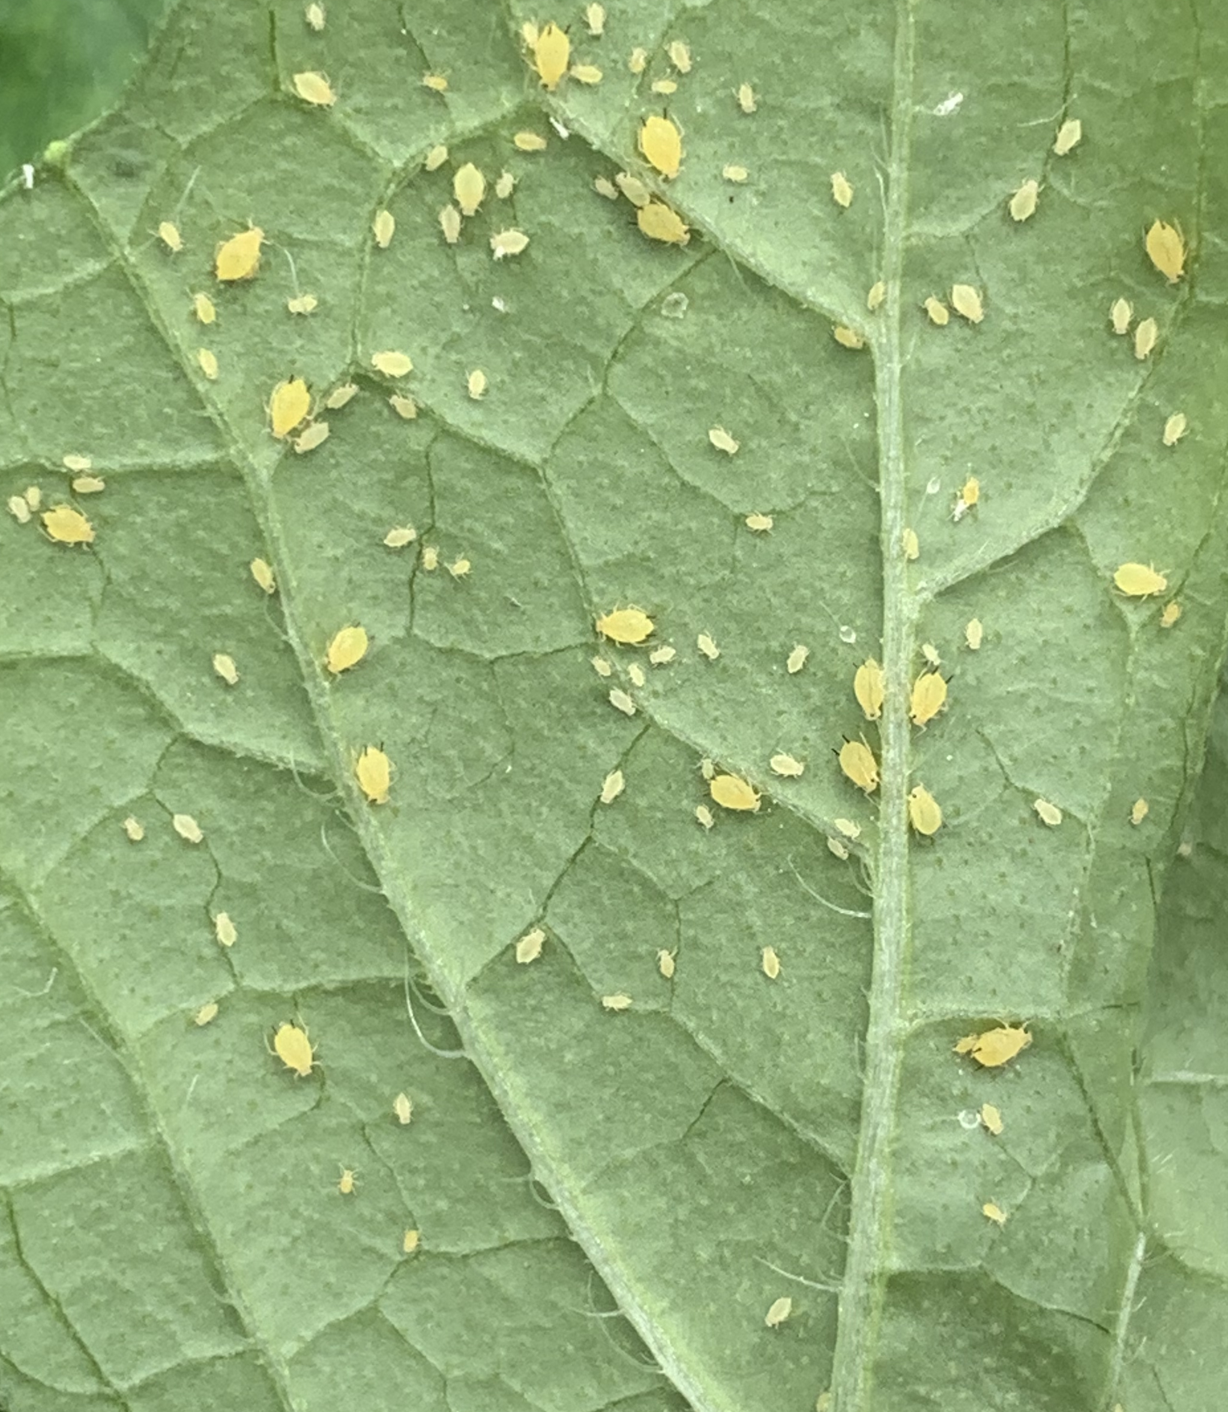
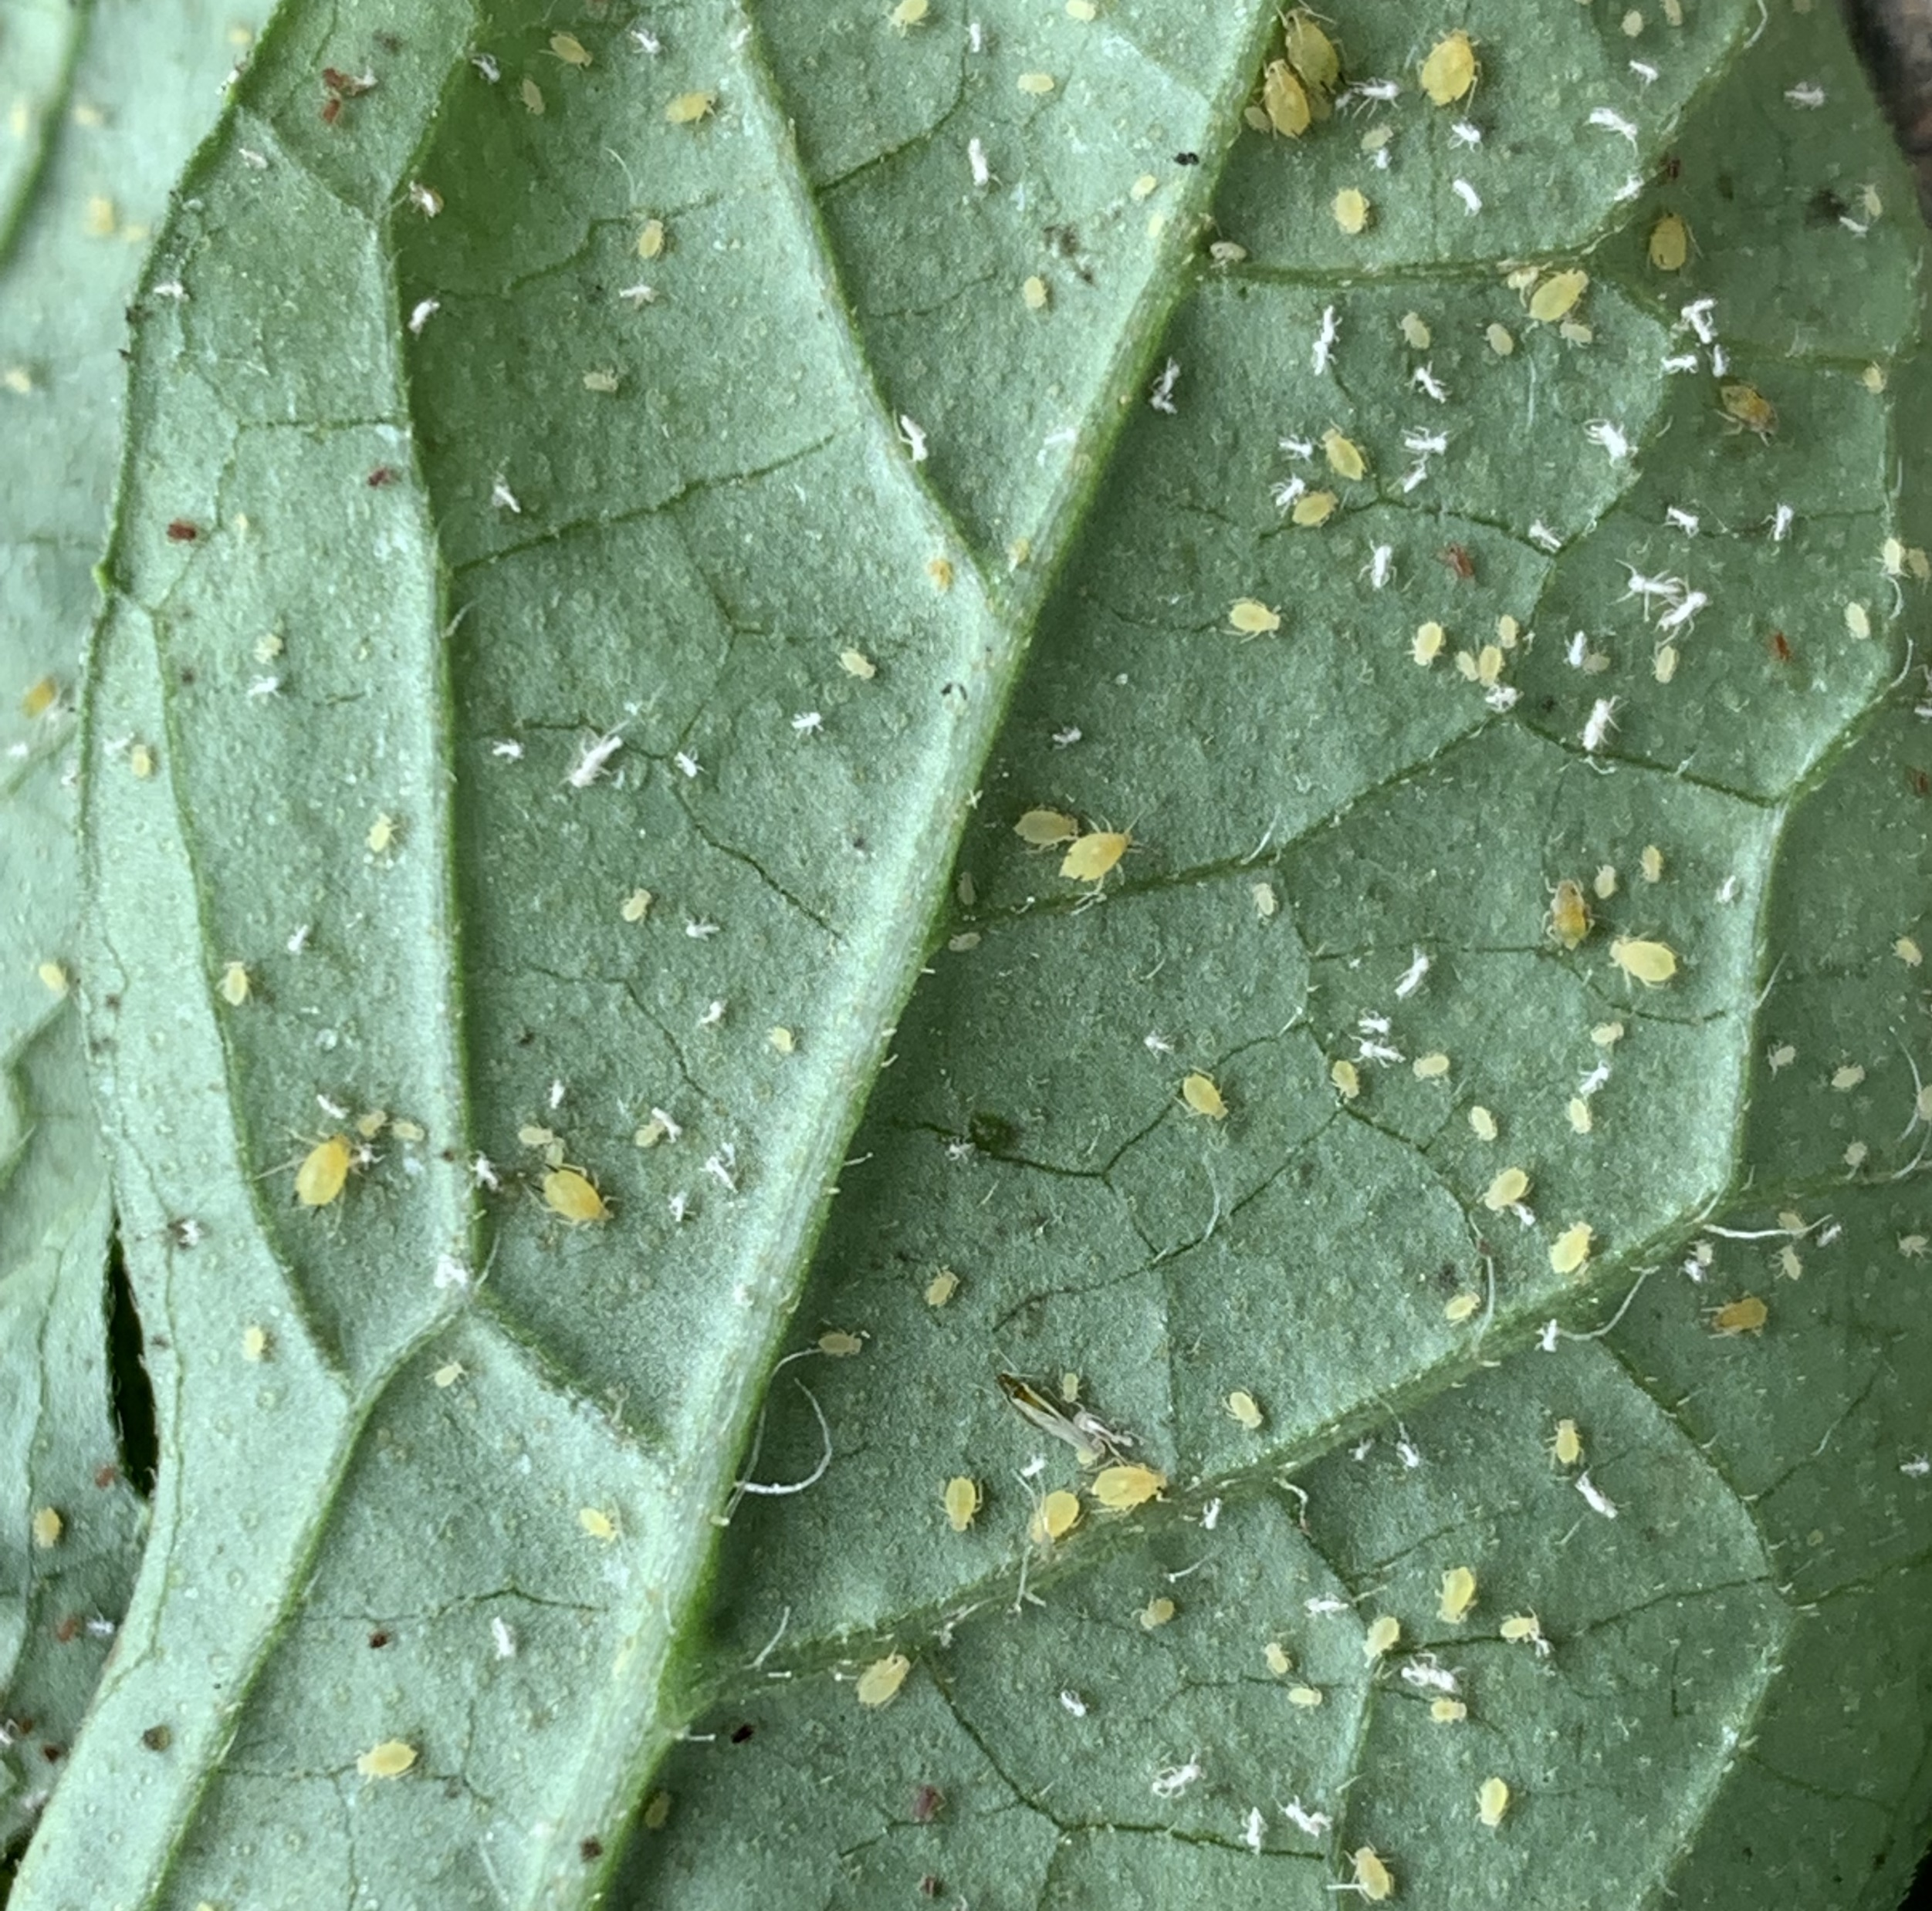
Aphid Counting
Original Picture

Slide 4
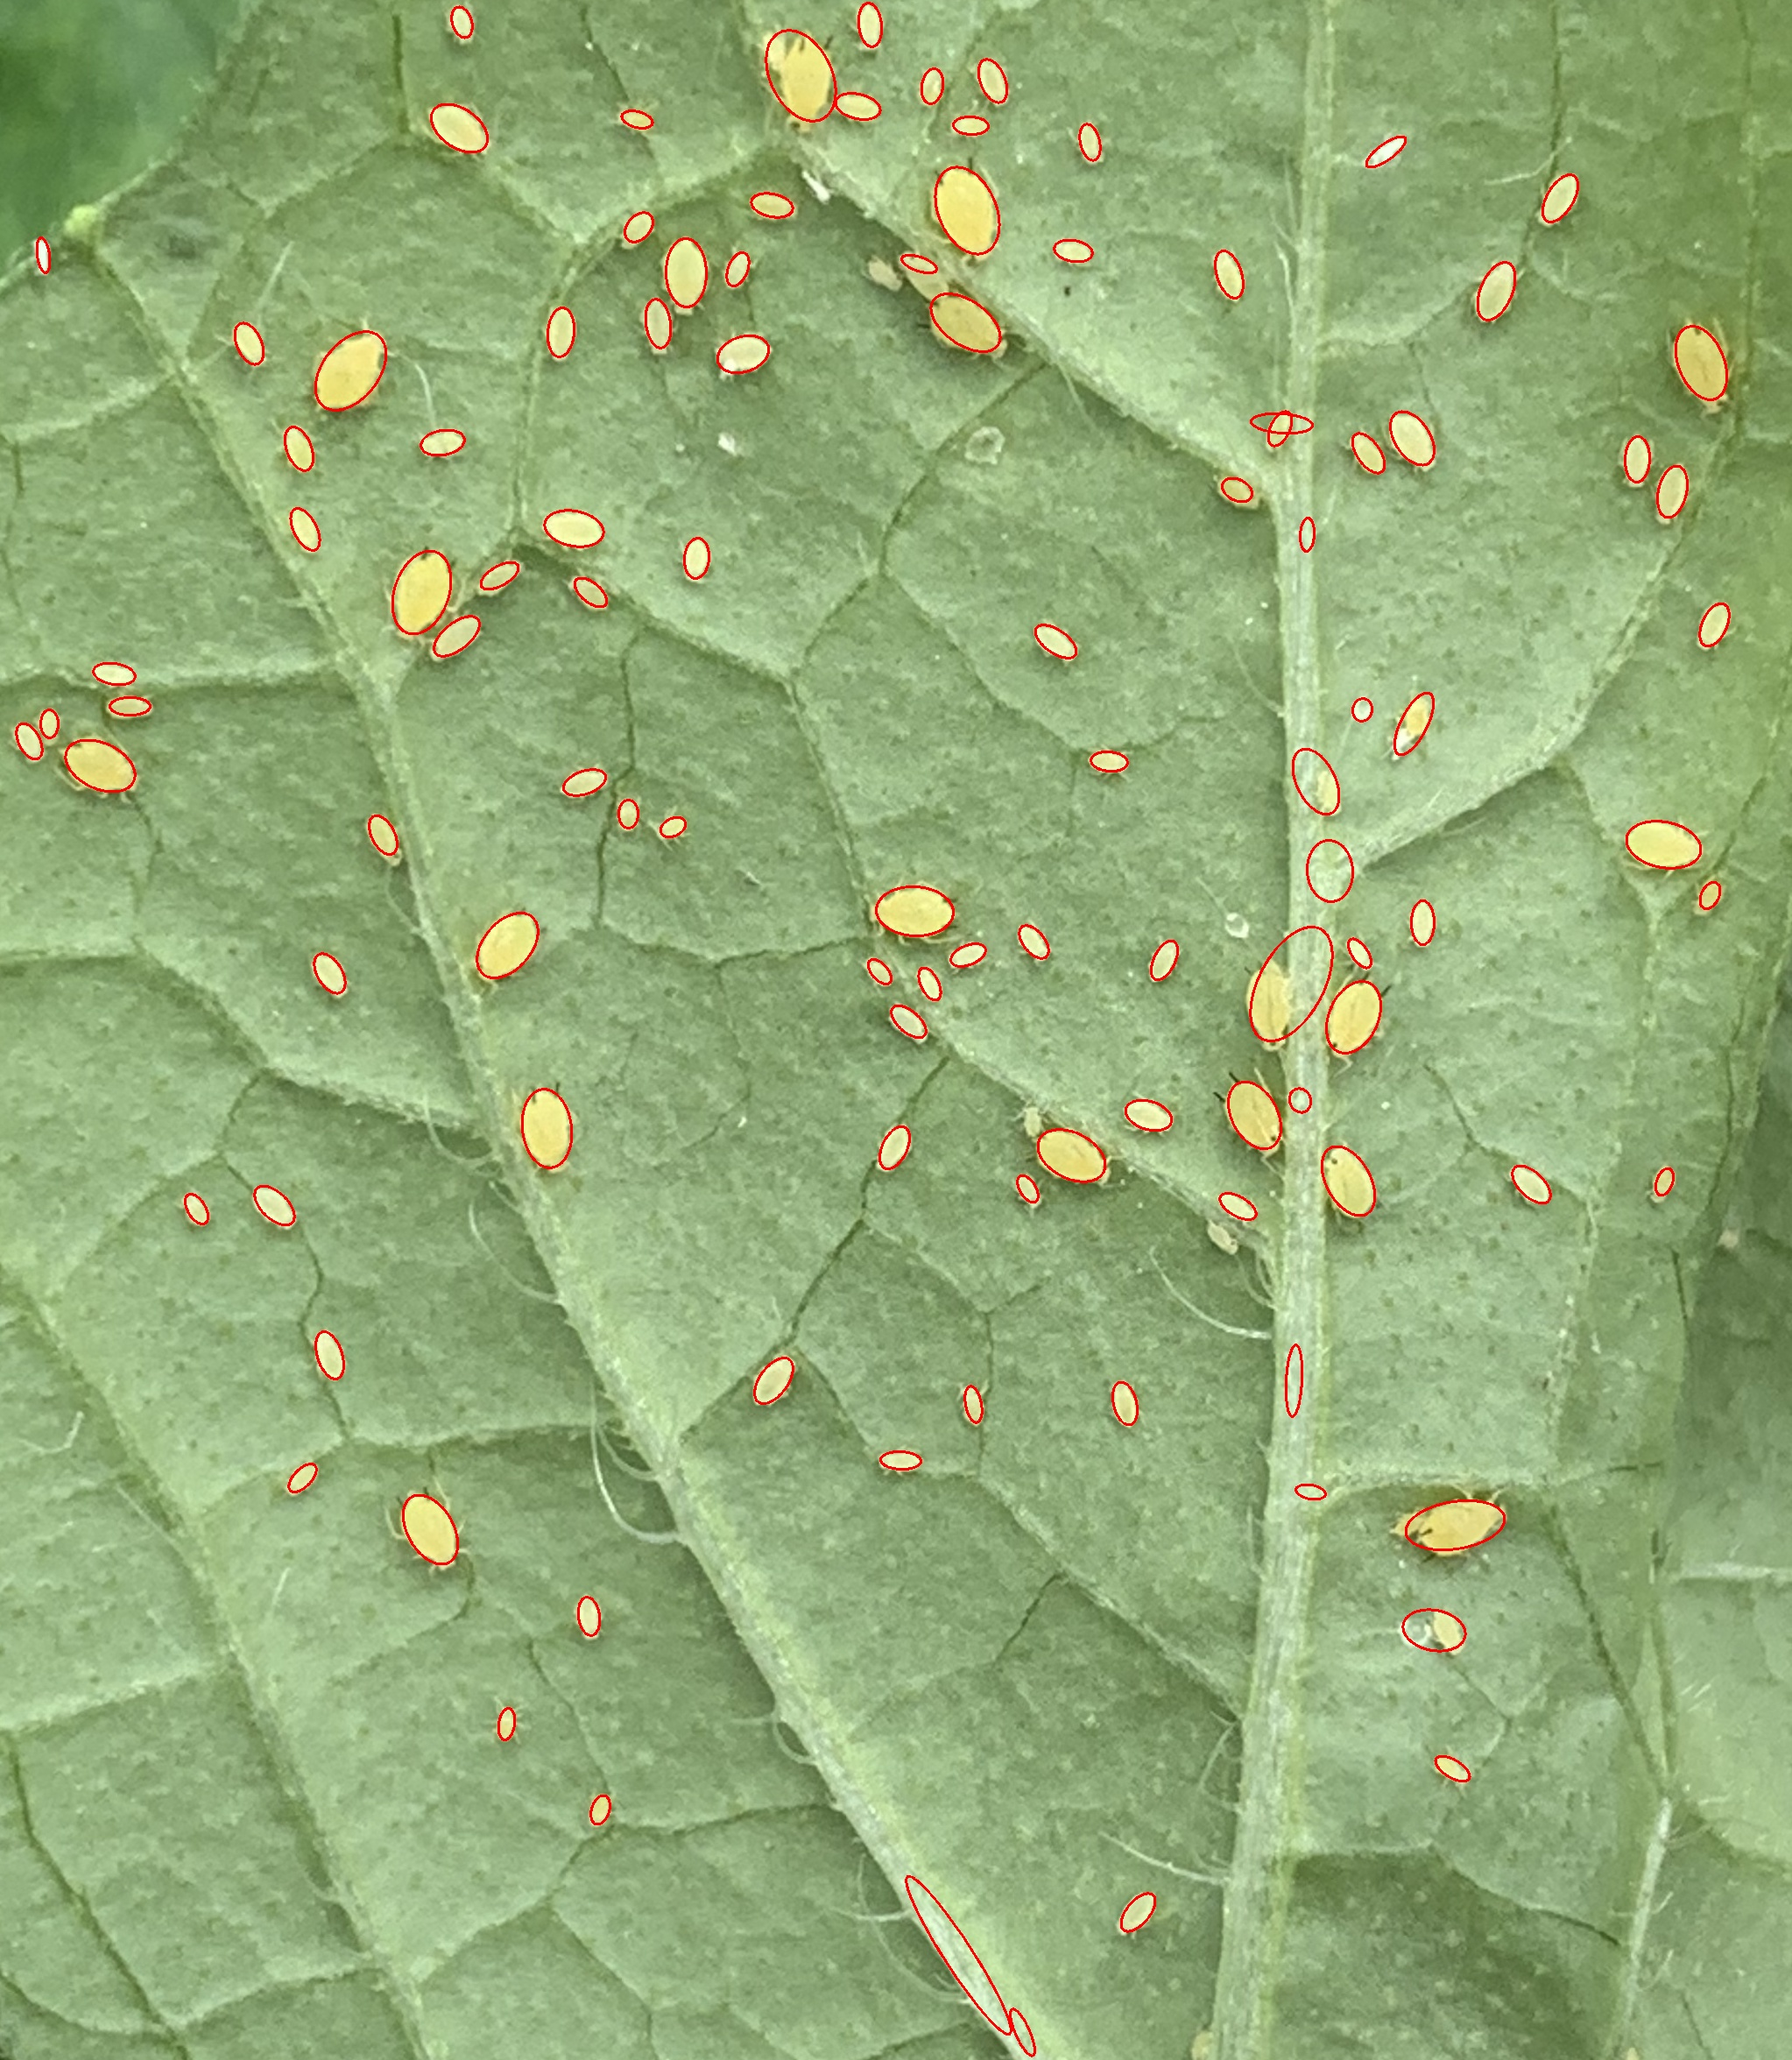
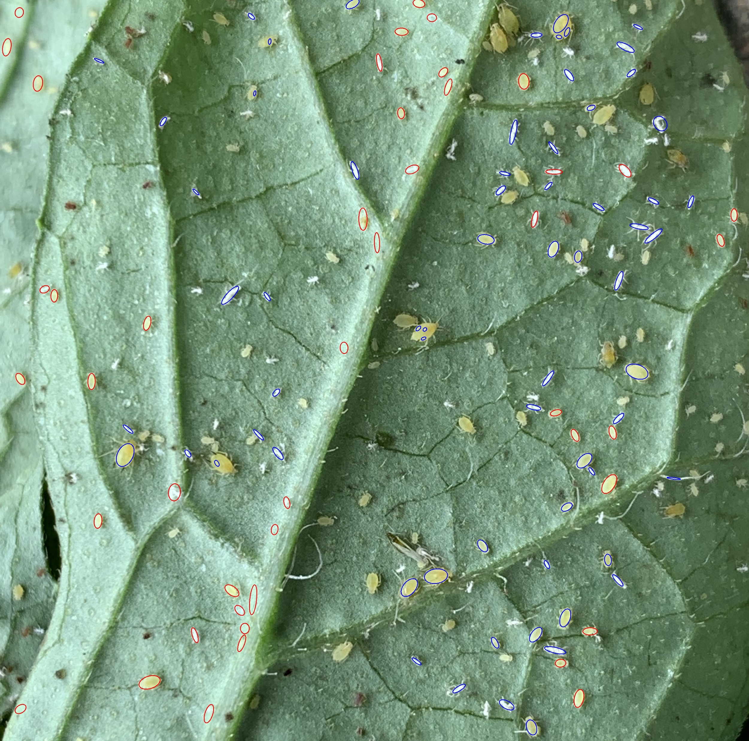
Aphid Counting
Counting: 108
Result Picture
Counting: Yellow: 71 Blue: 40

